Slide 1

Solid Resource (Waste) Management
Indian green service
Presented by
Kirtika Arora

Slide 2


About the Organisation - IGS
IGS is a registered trust under the Trusts act of India
It came into existence as a trust in the year 2010
Garbage Free World
Bringing about sustainable socio-economic change through environmental conservation

Slide 3
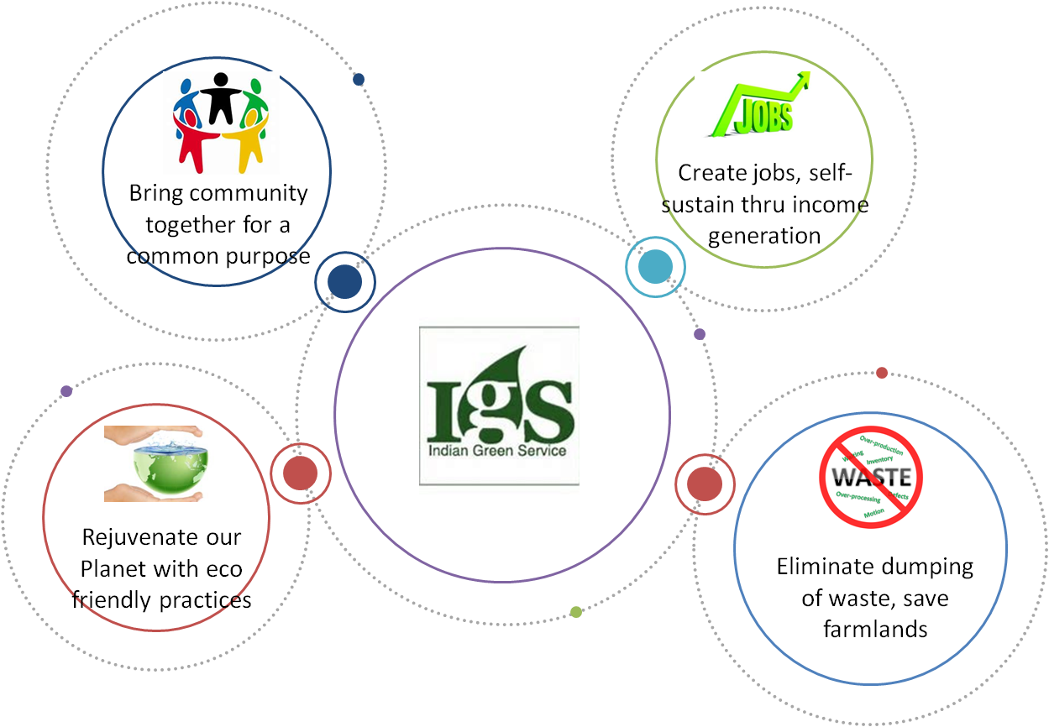
About the Organisation - IGS

Slide 4
Organisation’s Experience
Technical consultant for SLWM DRP preparation for GPs in Shamli in UP
Implementation of Solid Waste Management at Special Protection Group (SPG) Campus, Dwarka, New Delhi
Technical consultant on Solid and Liquid Waste Management – Rural context for World bank group (WSP) – Government of Rajasthan
Swach Bharath Abhiyan - Grameen (SBA) consultant for Government of Rajasthan (3 model districts), Government of Chhattisgarh
Technical support for Ernst and young for Solid and Liquid Waste Management projects
Partners with IICA for training Companies for creating Sustainable CSR initiatives on Environment

Slide 5
Specialised Areas of Service
Environmental strategy planning and operationalization of the same
Environmental research and dissemination
Solid and Liquid Waste Management services (Training, consultancy and implementation)
Advocacy initiatives for change in Environmental standards and implementation of laws
Impact assessment studies and evaluations

Slide 6
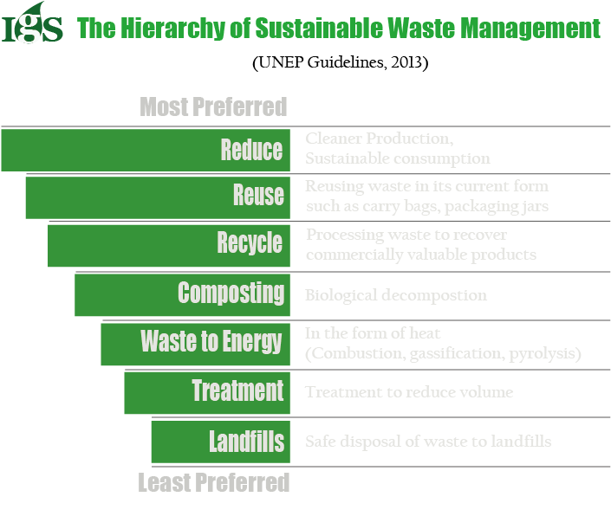
Our Theory of Change

Slide 7
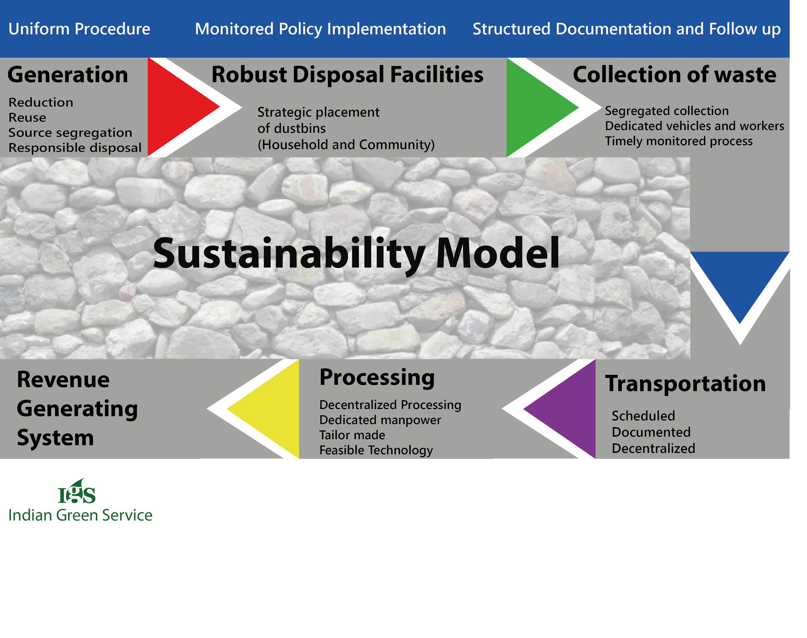
Solid Waste Management Model

Slide 8
Solid Waste Management Model
Collection and Segregation: Awareness activities will be conducted in the initial phases for household segregation of waste (primary segregation). Compartmentalised dustbins on the streets and in the common areas will be placed.
Transportation: Service delivery team (Dedicated vehicles and workers) will collect waste from households and community dustbins and clean streets. A collection vehicle with two separate compartments (bio-degradable and non-biodegradable) will be used to collect waste from households and these community level dustbins and transport to final disposal point.
Resource Recovery Centre (RRC): Collected and segregated waste will be collected at RRC for secondary segregation and processing.
Processing: The process will be decentralised and tailor made and feasible technology will be used for processing. Following options are proposed for the processing of waste.

Slide 9
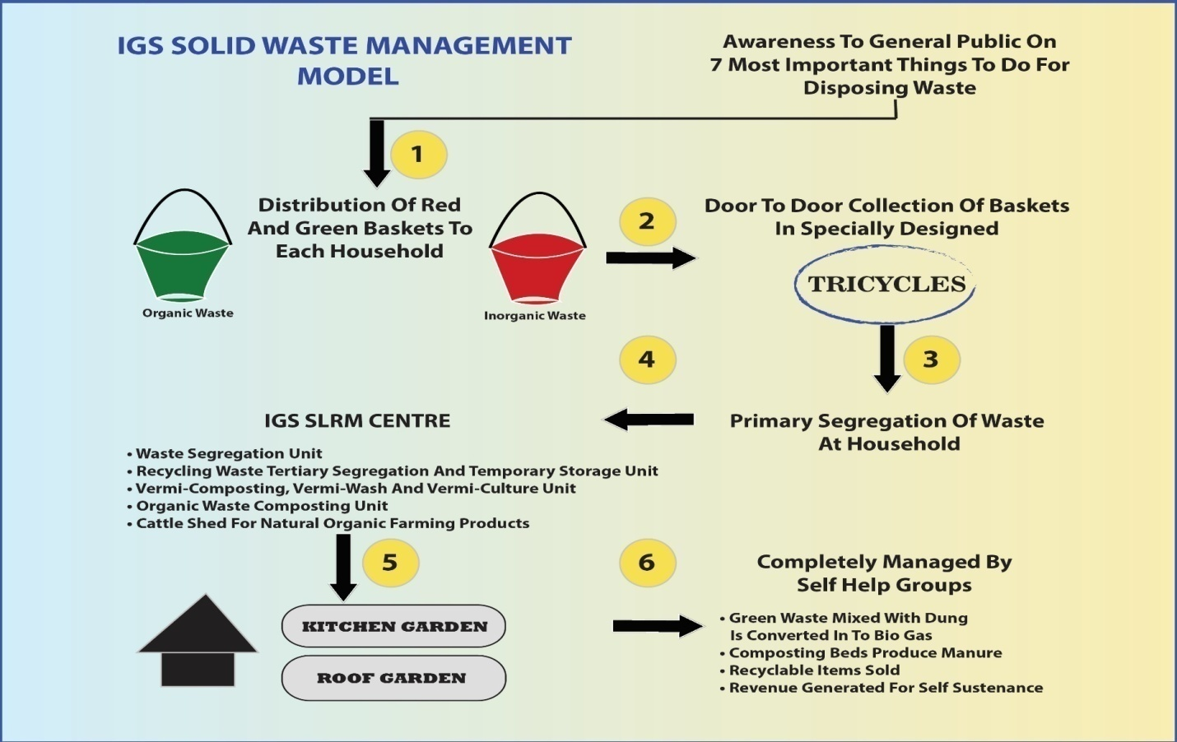
‘ZERO’ Waste Model - Illustration

Slide 10
Processing Technologies
Option 1
Composting Based Options
Source Segregated Collection - Secondary segregation (Resource Recovery Centre) via Manual Composting: Suitable for smaller areas with not more than 250-300 Kgs of waste output per day
Option 2
Waste to Energy (WtE)
Source Segregated Collection - Secondary segregation (Resource Recovery Centre) via Machine Composting: Suitable for areas with waste more than 1000 Kgs (1ton) of waste output per day
Source Segregated Collection - Secondary segregation (Resource Recovery Centre) - Bio-gas Generation: Suitable for waste more than 1000-2000 Kgs (1-2ton) of waste output per day. Space for usage of gas on regular basis (Restaurants etc.)
Source Segregated Collection - Secondary segregation (Resource Recovery Centre) - Electricity Generation: Suitable for campuses with waste more than 1000-5000 Kgs (1-5 ton) of waste output per day, where LEDs can be used for street lightening and others.

Slide 11
Composting - Bio-composters (Organic Waste Composting Machines)
Key Features
In-vessel composting for treatment of small quantities of segregated organic waste
Fully automatic natural composting machine
Energy positive composting solution
Odour free composting process
Uses forced aeration and mechanical agitation for rapid composting
Suitable to replace manure and fertilizers for agricultural purposes
Advantages
Manufactured in India and hence the cost is much lower than the other machines of the same category in the market.
Less maintenance is one main criteria for any machine used in a public space which this machine completely satisfies.
This composter is one of the very few machines which uses minimum electricity consumption.
Best quality compost
The input and output and any other parameters can be checked at any point of time by help of daily entry registers.

Slide 12
Waste to Energy - Gas/Electricity Generation Unit (Bio-Methanation)
Key Features
MultiFeed/Kitchen/Organic/Horticulture/animal dung can be processed
Plug and Play model – compact, factory fitted and modular
Bio gas, power and bio manure output
Less man power requirement
High rate bio-methanation
Long life – 15 years corrosion resistant - FRP material
Suitable for all climatic conditions as process happens inside the container/tower
Completely Odour free operations, as no storage of waste required
Advantages
Manufactured in India and Cost effective model (30% cost efficient)
Visibility
Uses microbial Solution and water
Container model, can be placed vertically and horizontally both
Can digest from 0.5 ton to 5 ton
Machine runs continuously for 24 hours and waste gets reduced with time and can be fed again at different times of the day.
Model comes with solar panel (Stand Alone Solar Panel) above it, which supplies electricity to the unit, required for its running.
Completely automated – System comes with camera, GPS and other technologies and can be remotely observed and assessed for any smaller issues. 2 years warranty

Slide 13
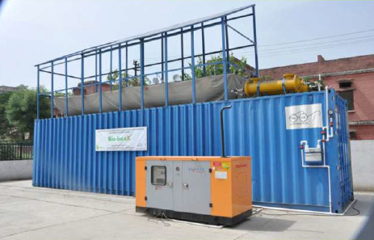
Waste to Energy - Gas/Electricity Generation Unit (Bio-Methanation)

Slide 14
Salient Features of Our Model
One stop solution for all the waste management requirements for any client and in any volume
Tailor made solutions aiding in attaining the real ZERO WASTE concept
President model for other states/districts to follow and can also act as Research/training centres
Geographically suitable for all locations and Replicable across the country with minimum effort
Complete thrust on awareness and behaviour change
Basic infrastructure to aid and sustain the behaviour change envisaged
Complete community and district as well as block officials’ ownership to execute, manage, monitor, evaluate proposed SLWM system
Complete transparency and accountability with management & reporting system and having a dedicated monitoring committee consisting mainly of local villagers
Self-sustainability of operation and maintenance is ensured with the help of user fee collection and waste by-products

Slide 15
Salient Features of Our Model (Cont.)
Waste reduction through extraction of recyclable material and composting and minimal disposal at landfill site
Integrated with government schemes for operational sustainability and is a Contribution to Swatch Bharat Mission, Government’s Flagship Program
Increased visibility for all stakeholders
Potential to be an sustainable income generation model for workforce; Employment generation and women empowerment (SHGs) in its fullest potential; Can be taken up as Social Entrepreneurship initiative model by youngsters
Achievement of 90% waste collection efficiency within 1 year of operation of project.
High level of transparency and accountability as all services are done under one roof and in one brand
Improvement in environment and aesthetics
Ideal for both rural and urban requirements as both decentralised and centralised approach made possible by strong network of organisations

Slide 16
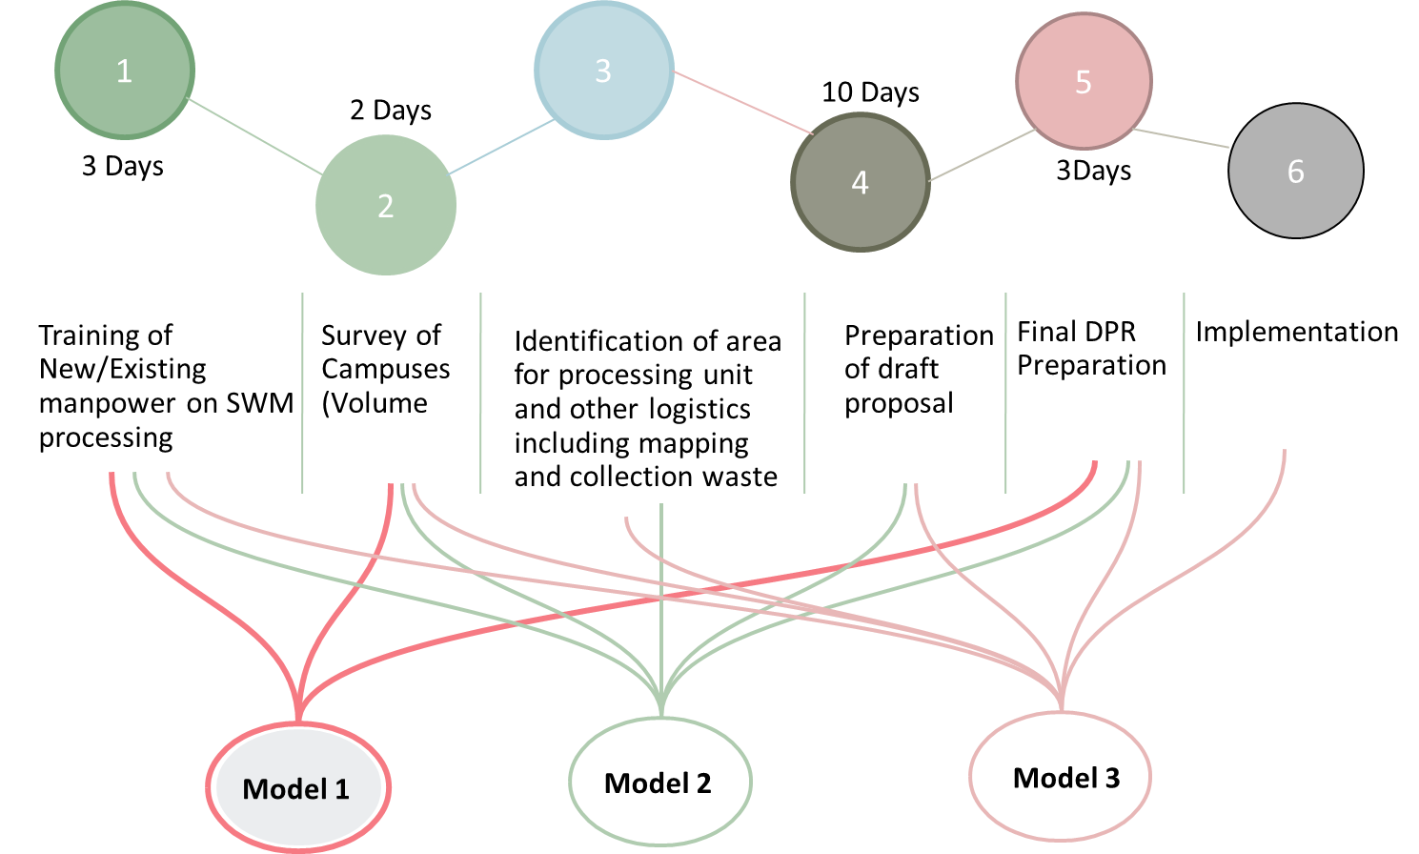
Working Models

Slide 17













Our Clients

Slide 18

Indian green service
PROJECT OFFICE
D 95, Okhla Phase 1, Okhla Industrial Area
New Delhi – 110020
PHONE
011-66462013 / 995 808 4964
E-MAIL
info@indiangreenservice.com
WEBSITE
www.indiangreenservice.com

